Slide 1
Community Representation 100 responses as of 04/16/2021
Notes:
This is what we’ve heard so far, we will continue collecting comments and community input
“other” includes Old Goucher, Madison Park, Midtown, Downtown, Union Square, Fells Point, Waverly, Canton, Ashburton, Fulton Ave, and Medfield, and groups including Rawlings Conservatory, MD Zoo and running/bicycling clubs

Slide 2
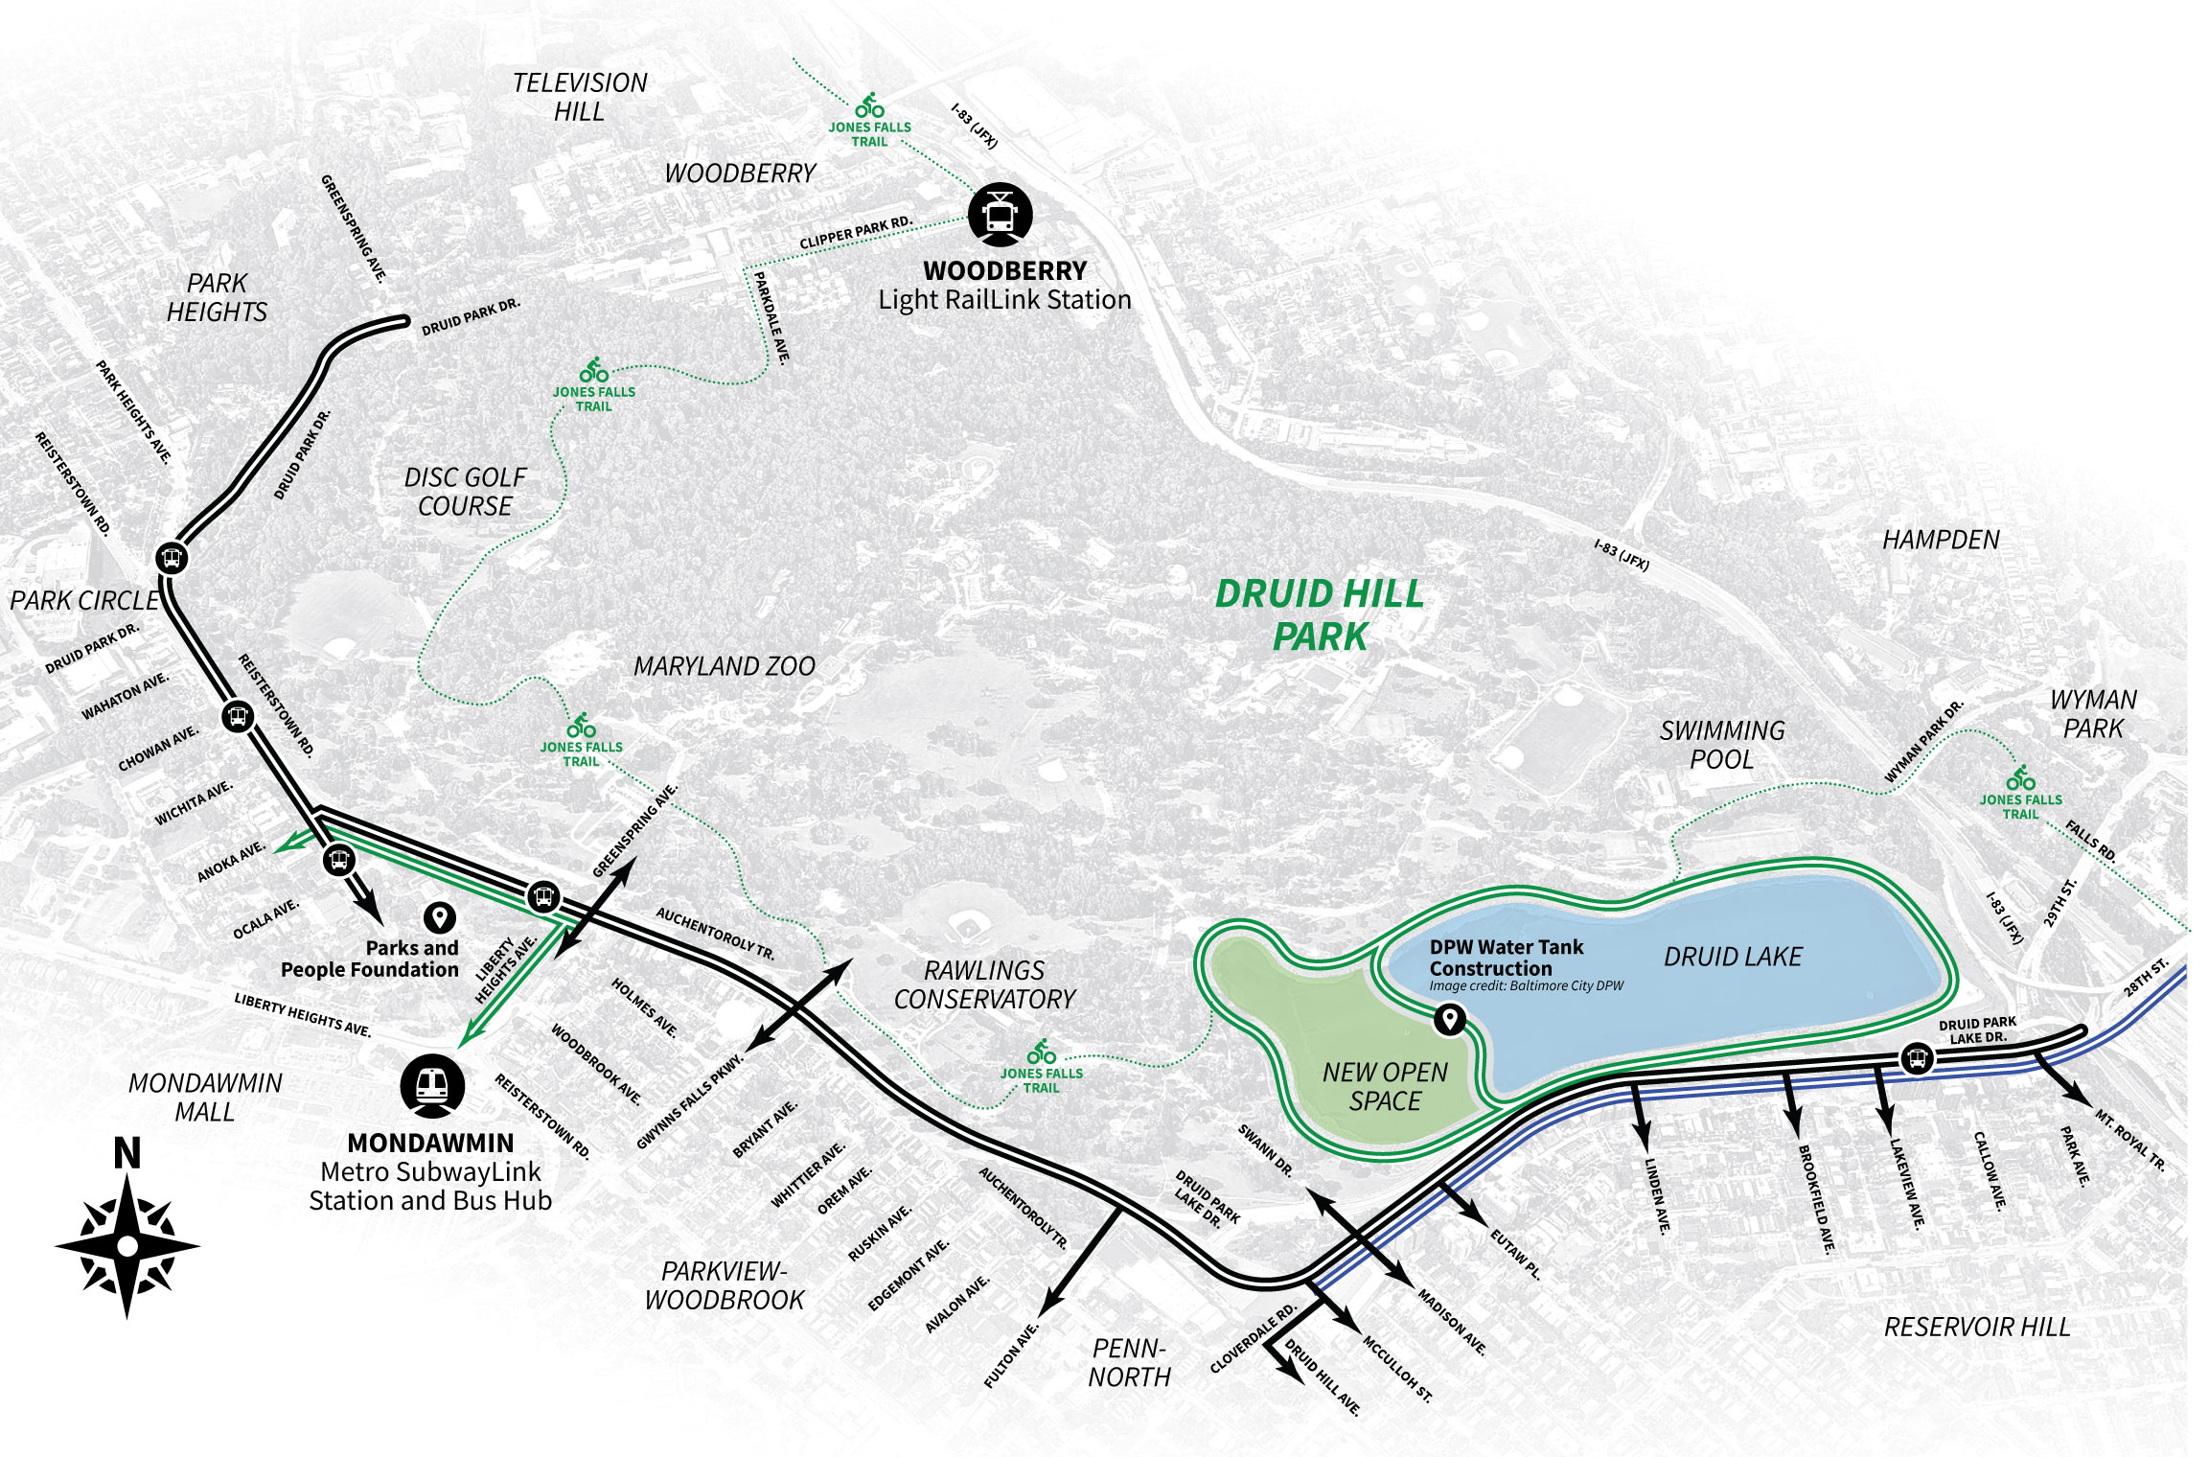
Main connectors to Druid Park Lake Drive
Notes:
Top answers:
28th and 29th Streets an I-83
Eutaw Place
Madison
Linden
Auchentoroly Terrace
Keswick
Wyman Park Drive
Lakeview Ave
Fulton Ave
Brookfield Ave
Others that were mentioned with 1-2 entries included Union Ave, Reisterstown Road, Park Ave, McCulloh St, Druid Hill Ave, Cloverdale, Sisson St, Keswick Road.
The Big Jump and Jones Falls (E Coast Greenway) were referenced several times

Slide 3
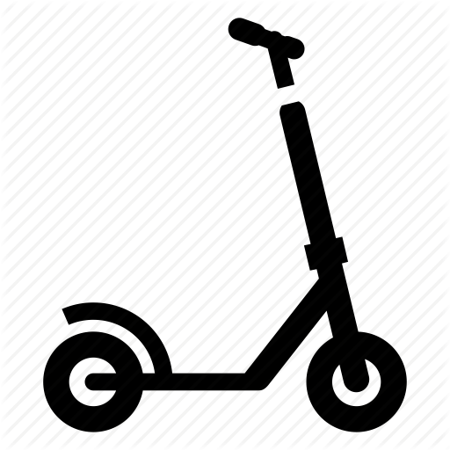
Which modes of travel should be incorporated?
Notes:
Pedestrian / assisted mobility – 87
Bicycle – 85
Public Transit – 67
Scooter - 53
Motor vehicles - 49

Slide 4
What is your biggest concern when crossing Druid Park Lake Drive on foot, bicycle, or with and assisted mobility device?
The road is too wide, there are too many lanes
Not enough crossing times at lights, prioritized for vehicles not pedestrians
Speeding Motorists
Getting hit by a car
Confusing construction
Inadequate bicycle safety barriers
Not enough cross walks
Motorists don’t stop at red lights
Not enough connectivity to the park
Notes:
Speeding cars
Safety / getting hit by a car
Crosswalks
lengthy wait time for pedestrians
time it takes to cross the road
functionality of push buttons
not enough crossing points
lighting
sidewalks
Motorists running red lights.
Traffic

Slide 5
What is your destination within Druid Hill Park?
The Jones Falls Trail, walking paths, the lakeside loop, and “no particular destination” were overwhelmingly popular answers
Notes:
The combined response for Jones Falls Trail, walking paths, no particular destination, and the lakeside loop is over 275
The combined athletic fields, basketball courts , tennis courts had 56 responses
Rawlings Conservancy 50
Picnic groves and pavilions 41
Maryland Zoo 37
Playgrounds 32
Other popular destinations were the swimming pool, Zen Garden, disc golf course
Notable “other” includes birdwatching, Safety City, farmers market, and nature play space

Slide 6
What additional crossing points into Druid Hill Park should be evaluated?
“Restore the historic entrances to the park, all blocks should have an access point”
Notes:
Most mentioned answers:
Linden Avenue
Eutaw Place
28th / 29th / somewhere near I-83
Lakeview Avenue
Mt. Royal Terrace
Park Avenue
Callow Avenue
Brookfield Avenue
Liberty Heights Avenue
Auchentoroly Terrace
McCulloh Street
North Fulton Avenue
Union Avenue
Seneca Street
Restore the historic entrances to the park

Slide 7
What type of traffic calming techniques would you like to see?
Notes:
Acknowledge that we are asking people’s interest - not as designers but for general support
(There was a comment "I don't think these are appropriate questions to ask people that aren't road design experts. Instead ask questions about values (reduced speeds, easier crossings, etc.)“
“other” comments included –
get rid of the road and make it a bike/ped path
tear down 83
synchronized traffic lights
large tree-lined median
extend the Big Jump
remove the Big jump
more stop signs
Don’t create barriers to existing alleys/neighborhood parking access

Slide 8
What else would you like to tell the design team?
Please do not let people who live outside of the neighborhood override the voices of the residents
This is a main thoroughfare to I-83, congestion does not make people happy
Motorized vehicles should not be the priority
More pedestrian access points to the park!
Too many lanes
Do not reconnect the MRT ramp
So many cars make illegal u-turns
Druid Park Lake Drive is suffocating the park
Make DPLD a bike and pedestrian only greenway
I use Druid Lake Park Drive to access 83 South to go to work
It should take less than two-minutes for someone to walk or bike to the park from homes or businesses along DPLD
The look and feel of the road should be similar to the look and feel of the park
Design from the human perspective
Busses into the park!
Notes:
Although most comments have been in support of reducing lanes, slowing traffic and providing safer access to the park for pedestrians and bicyclists, there have been remarks about not increasing commute times for people both within and outside of the community.
Other comment topics include:
Functionality of the pedestrian push buttons
Lighting
Sightlines around curves
Motorists running red lights
Potholes and general maintenance, maintenance of the Big Jump barriers
Incorporating green infrastructure
Additional sidewalks and access to the park

